Slide 1

SSCM Short Course in Genetic Epidemiology 18 – 22 April 2016
Imputation: enrichment of SNP arrays using Next generation technologY
Tutor: George Mc Mahon
Email: epgmm@bristol.ac.uk

Slide 2
Contents
Introduction
Motivation: Three advantages of imputation
Phasing
Reference panels
Association analysis with imputed data

Slide 3
What is Imputation
Example definition in the context of genome-wide association studies
“Imputation is the prediction, both of SNPs not typed in the sample and genotypes missing in the sample, using observed genotypes in the sample and observed genotypes in a reference panel.” (Marchini and Howie, 2010)
Notes:
Imputation has several definitions:
In statistics, imputation is the process of replacing missing data with substituted values.
Imputed values may be obtained using a model based on available observed values
multiple regression
multiple imputation

Slide 4
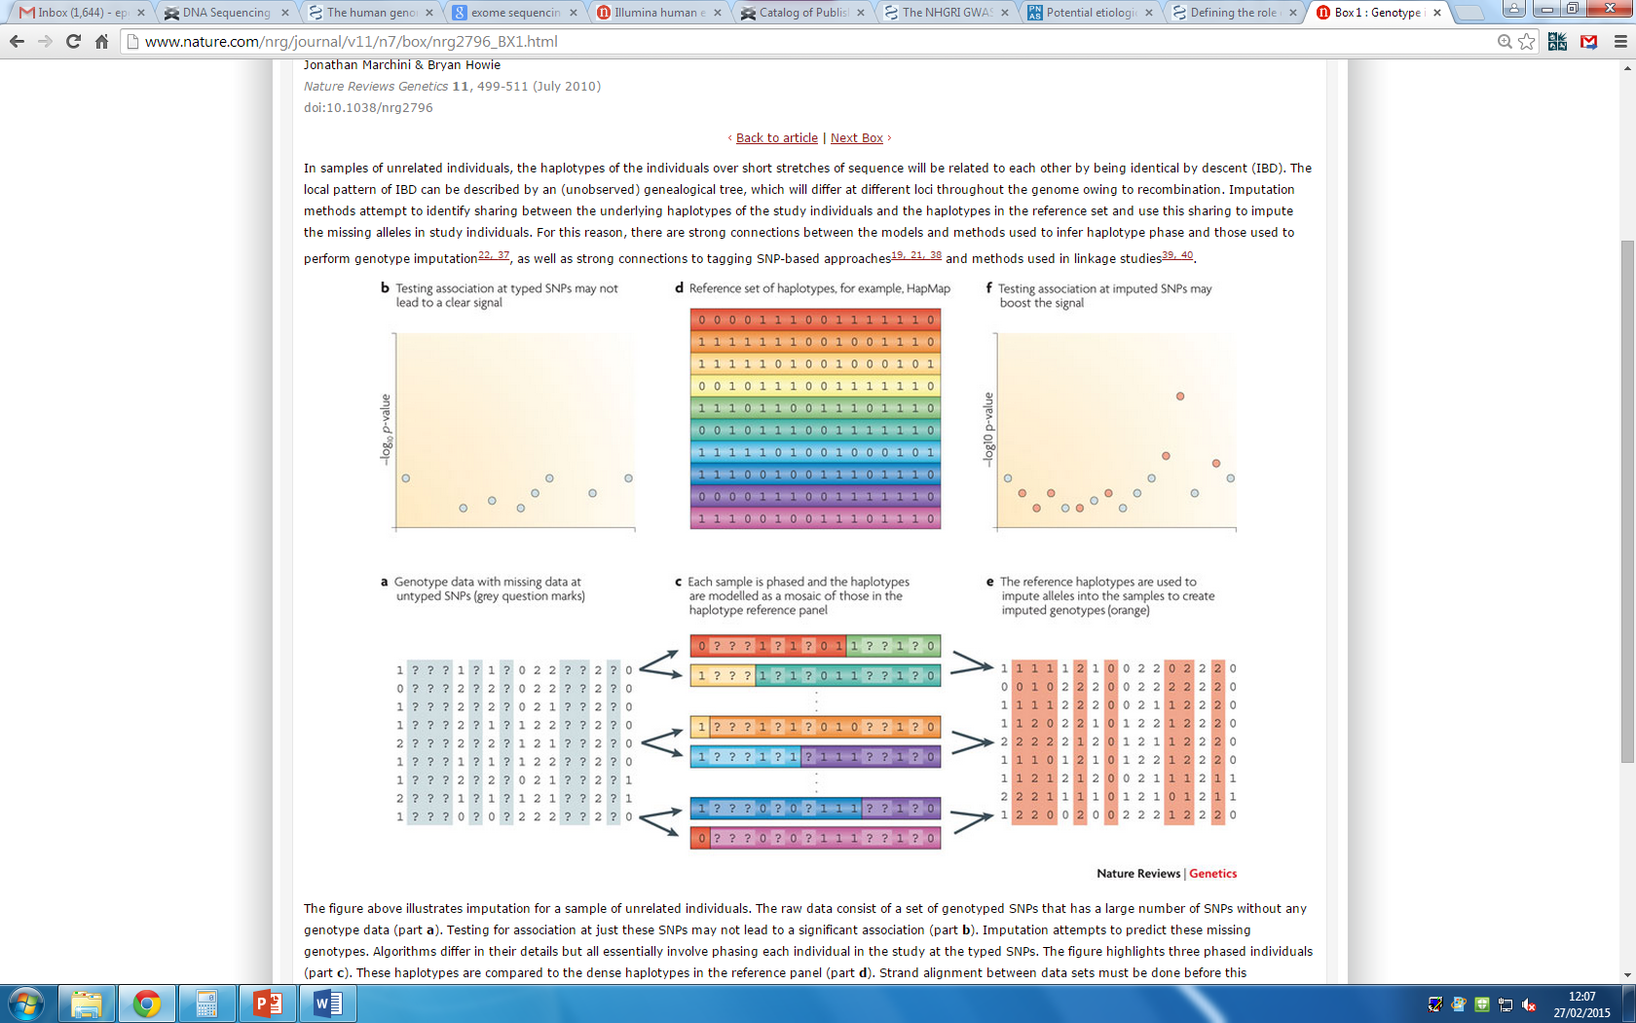
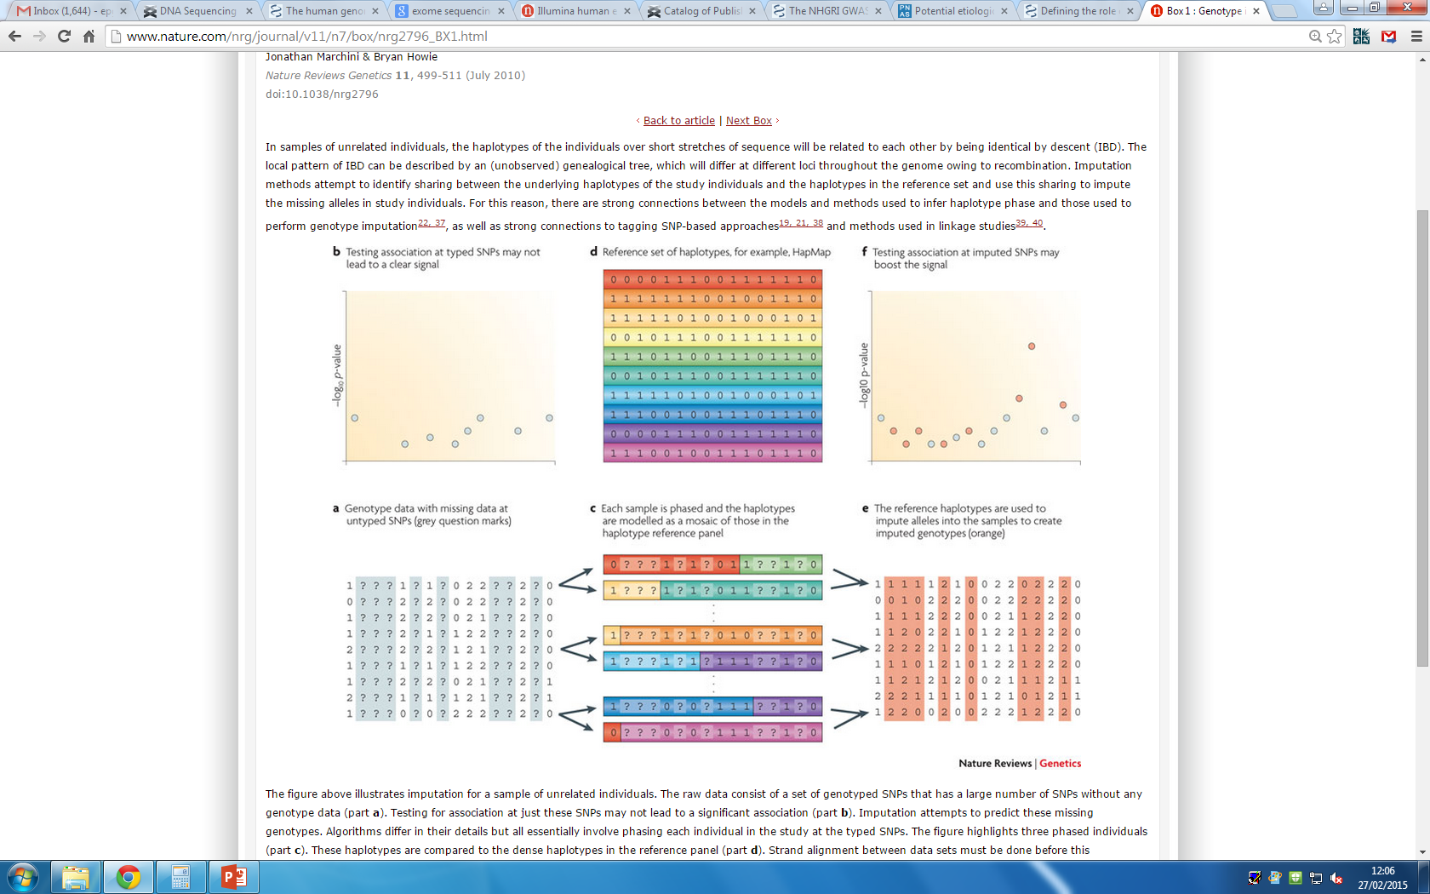
Imputation overview
2) Haplotypes compared to reference panel
3) Reference panel with dense genotyping
4) Underlying true haplotypes identified
1) Partially genotyped sample with missing genotypes
4) Missing genotypes filled in
adapted from (Marchini and Howie, 2010)
Notes:
Sample data
Reference panel with dense genotyping
Match up of sample data with reference panel data

Slide 5
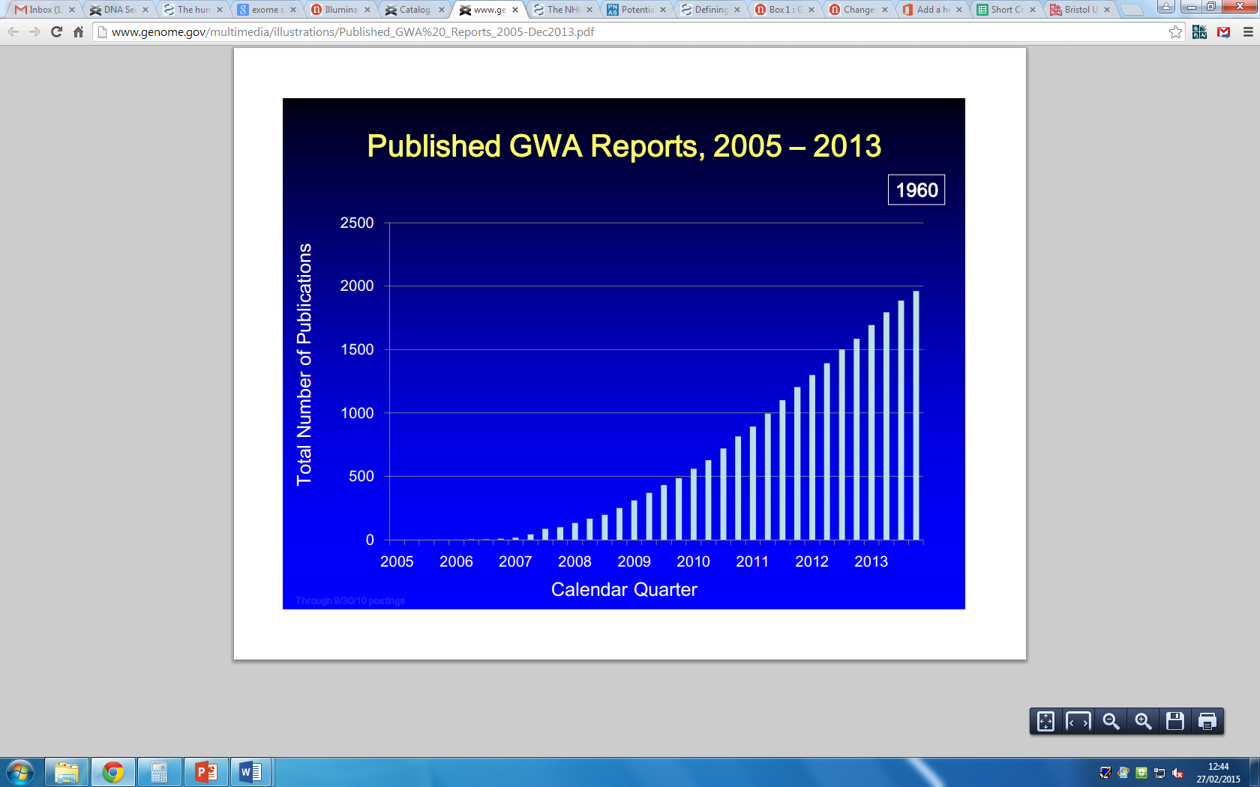
Why impute?
downloaded from http://www.genome.gov/gwastudies/
The discovery of novel genetic associations is limited partly by availability of genetic marker data which in turn is limited by cost
Notes:
The Human Genome Project draft sequence was announced in 2000
The HapMap project began in 2003
The 1000 Genomes project in
And so on, the availability of markers known to exist in the Human Genome is increasing
One of the first successful GWA was the Complement Factor H Variant and Risk of Age-Related Macular Degeneration.
Other early examples are the WTCCC study in 2007
Since then the number of GWA studies has increased partly due to the larger availability of GWA markers and partly due to their success

Slide 6
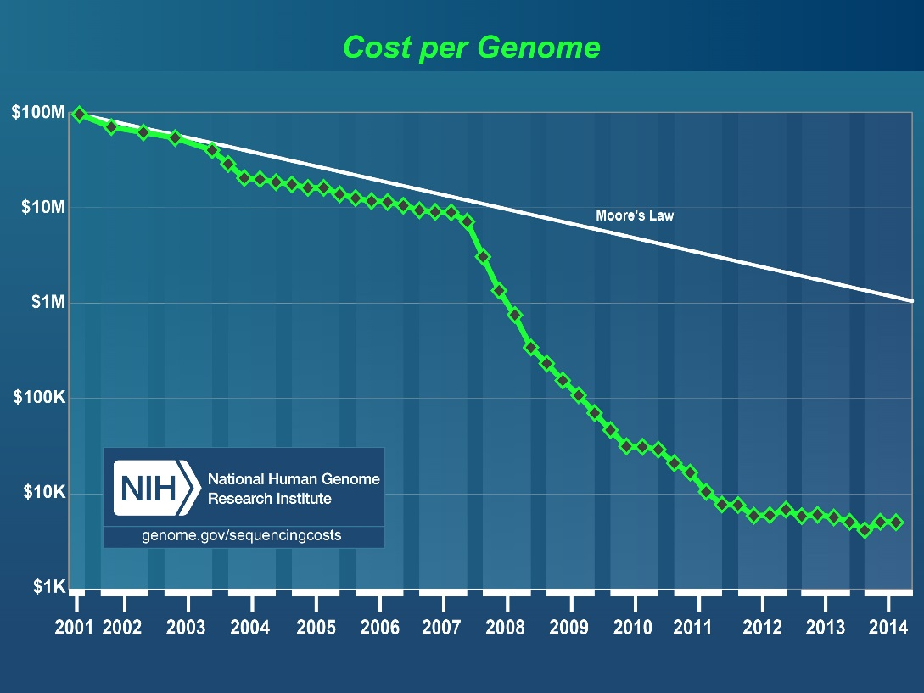
Sequencing costs
The cost per sequenced genome has fallen rapidly in the fifteen years since the publication of the human genome sequence due to improvements in sequencing technology
However it is still too expensive to sequence large number of subjects
Imputation helps to “fill in” sites that haven’t been genotyped.
Notes:
The cost per Genome has dropped at the same time, but it is still too expensive to conduct large studies where each sample is sequenced to a level similar to publically available resources.
At the time of the Human Genome Project the cost was 1 billion
By July 2014 it was 5 thousand
Exome sequencing, where only genic regions are sequenced costs about 500 to 1 thousand dollars
Chip based genotyping costs in the 100 dollar range.
Imputation allows the use of information from different samples in a second sample that does not contain as many markers.
In this way it allows more markers to be tested without the associated costs of having to actually genotype subjects at those sites.

Slide 7
Motivation: Three advantages of imputation
Boots power
Fine-map association
Meta-analysis

Slide 8
A. Boost power
A conventional sense of an increase in power but by a slightly different route.
“The probability of detecting a variant assumed to be causal” – Marchini J, Howie B (2010)

Slide 9
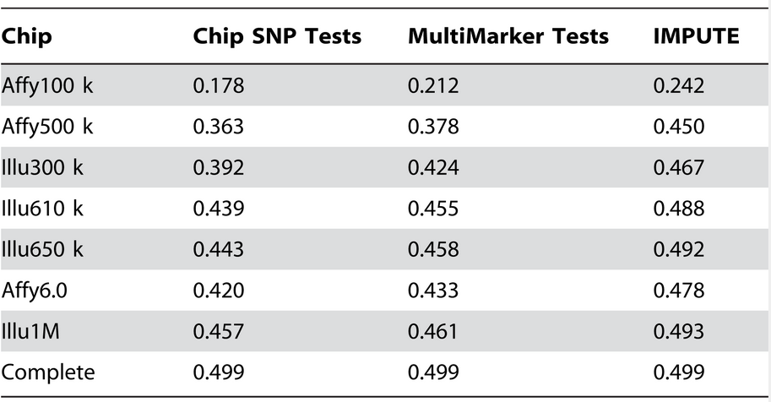
Boost power
(Spencer et al., 2009)
Genotype imputation can be used to boost the power of each chip and it also decreases differences in power between the chips.
Notes:
Power for each chip
They simulated data under the assumption that a particular allele is causal
Then looked to see whether any SNPs on the respective genotyping chip, within a large region around the causal SNP attain the specified significance level
Sample size of 2000 cases and 2000 controls
Relative risk at the causal SNP of 1.3
P-value threshold of 5×10−7

Slide 10
B. Fine-map association
Can increase the accuracy of the causal variant by identifying the marker that is most strongly associated out of directly genotyped and imputed markers.
Increasing the number of markers can help reduce the size of the region where an association signal is located (among other factors such as linkage disequilibrium and recombination rates)
Linkage studies typically used 500 markers evenly spaced throughout the genome and identified regions that could contain hundreds of genes while genome-wide association studies, which use millions of markers identify smaller regions, typically 500 kb in size
Imputation can help to pinpoint the location of the causal variant within this small region

Slide 11
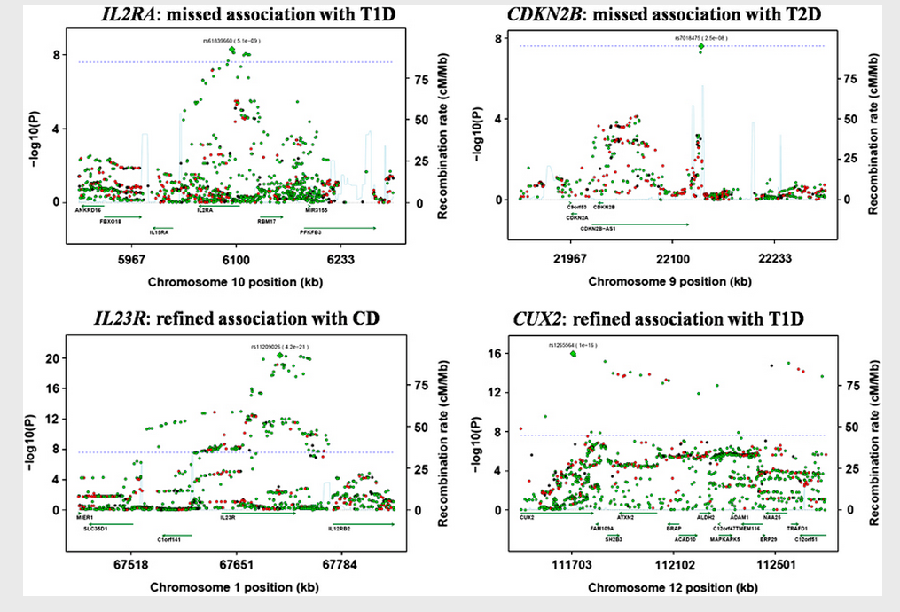
Fine-map association
(Huang et al., 2012)
Wellcome Trust Case Control Consortium (WTCCC) Phase I genotype data was re-analyzed after imputation using the 1000 genomes as reference
Identifies two “new” associations which were already confirmed in other studies
Notes:
Two “new associations”:
Within the IL2RA gene for association with type 1 diabetes
In proximity of the CDKN2B gene for association with type 2 diabetes
Refined associations:
One in exon 9 of IL23R in association with Crohn’s disease,
predicted to be probably damaging by PolyPhen2
A variant is in the CUX2 gene region for association with type 1 diabetes
evidence of association two orders of magnitude higher (10-14 to 10-16)

Slide 12
C. Meta-analysis
Genetic effect sizes in common diseases are typically moderate to small necessitating large sample sizes to obtain 80% power.
This level of sample size is typically too large for any one study.
Study must combine data in meta-analysis.
Imputation from a shared reference panel makes this easier by ensuring the there is a high degree of overlap in the variants tested in each study

Slide 13
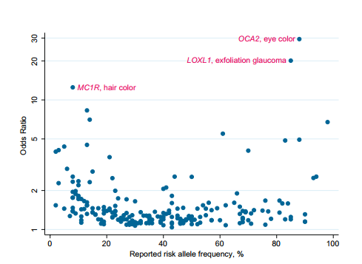
Genetic effect sizes in common diseases
(Hindorff et al., 2009)
Odds ratios for discrete traits by reported risk allele frequencies in the GWAS catalog by 2009
Notes:
GWA studies reported in the GWAS catalog by 2009
Median risk allele frequency was 36% with an interquartile range (IQR) of 21%-53%.
Median odds ratio was 1.33 with an IQR 1.20-1.61
Overall modest effect sizes being reported.
Published odds ratios for discrete traits by reported risk allele frequencies.
Y axis is on the log scale.

Slide 14
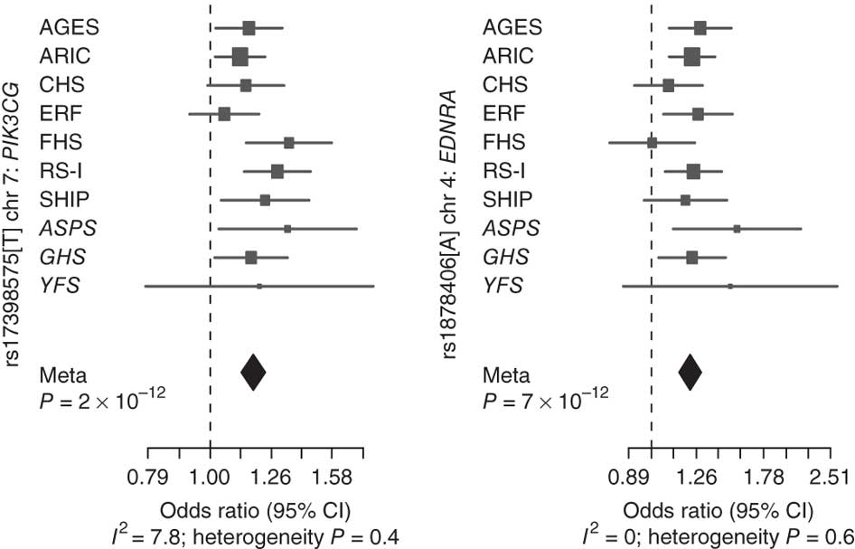
Meta-analysis
(Bis et al., 2011)
A meta-analysis of genome-wide association data in 31,211 participants of European ancestry from nine large studies
Studies used various DNA arrays to generate genotype data but all imputed to approximately 2.5 million SNPs described in the HapMap.
Notes:
e.g
ARIC Affymetrix Genome-Wide Human SNP Array 6.0
CHS Illumina 370CNV Duo® BeadChip

Slide 15
Phasing
Phase – the way in which alleles are associated together on a chromosome
Modern methods of imputation require genotype data to be in phase prior to imputation
Current large scale genotyping processes result in genotypes at each locus e.g SNP1 AA, AG or AG, SNP 2 TT, CT, CC, but no information about which alleles are associated together on a chromosome.
For example, subject A has genotypes AG and TC at these two sites. When these were in phase, they could have been A-T and G-C or A-C and G-T. This information is useful for current imputation methods.

Slide 16
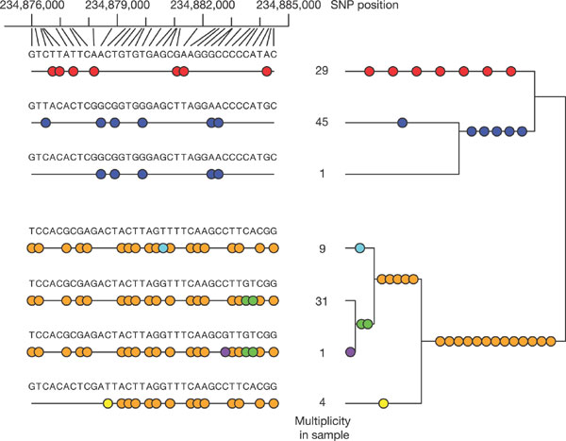
Phasing
(International HapMap Consortium, 2005)
Haplotype block structure of human genome
Notes:
Region of chromosome 2 containing 36 SNPs
Very low levels of recombination events
Plot shows the seven different haplotypes observed over this region and their frequency
Coloured circles indicate SNP positions where a haplotype has the less common allele at that site.
Groups of SNPs all captured by a single tag SNP (with r² ≥ 0.8) have the same colour. Seven tag SNPs corresponding to the seven different colours capture all the SNPs in this region
Genealogical tree shown on left

Slide 17
Clarkes algorithm
(Clarke ., 1990)

Slide 18
EM algorithm (Excoffier and Slatkin 1995)
 |  |  |  |  | Haplotypes
 |  |  |  |  | A | G | C | T
Genotypes |  |  |  |  | A | A | C | A
A | G | C | T
A | A | C | A
 |  |  |  |  | A | G | C | A
 |  |  |  |  | A | A | C | T
A | G | C | T |  | A | G | C | T
A | G | C | T |  | A | G | C | T
Expectation step – the haplotype frequencies of the previous iteration are used to calculate the probability of each pair of genotypes.
Maximisation step – The probability of each pair of genotypes is assumed to be true and the haplotype frequencies for the next iteration are obtained by counting.

Slide 19
Worked example
We have a sample of ten subjects, 6 of whom have the first genotype listed in the previous slide (ambiguous) and 4 of whom have the second genotype
We assume, initially that the ambiguous genotypes lead to haplotypes which are equally likely.
Therefore, our initial expectation step results in the following haplotype frequencies: AGCT/AACA 30%, AGCA/AACT 30%, AGCT/AGCT 40%
We then complete the maximisation step by counting the number of each haplotype
This gives us haplotype frequencies of AGCT 55%, AACA 0.15%,AGCA 0.15% and AACT 0.15%.

Slide 21
Newer methods of phasing
EM and Clarkes algorithm useful only for a small number of loci.
Approximate coalescent approach
Models new haplotypes from old haplotypes using mutation and recombination.
Over small genomic distances, haplotypes tend to look similar to each other.
For example haplotypes with known phase 1100 and 0001 are observed
Haplotypes 1101 (formed by recombination) or 0011 (formed by mutation) are more likely, than haplotype 1111 (formed by a recombination and a mutation).
Examples include Mach, Impute and Beagle
BEAGLE model recombination and mutation implicitly by clustering haplotypes at each locus dependent on sample size and amount of linkage disequilibrium.

Slide 22
Reference panels
HapMap Phase II
269 subjects and 3.1million SNPs.
25–35% of common SNP variation in the populations surveyed
HapMap Phase III
1,184 subjects and 1.6 million SNPs
1000 Genomes reference panel
Phase I, 1,092 individuals from 14 populations and 40 million markers.
One of the first projects to sequence the genomes of a large number of people.
Able to detect variants down to a minor allele frequency of 1% or higher.
Captures up to 98% of single nucleotide polymorphisms of markers (MAF > 1%) variation in the population studied
Phase III, 2,504 samples and 80 million markers

Slide 23
Reference panels
UK10K
3,781 whole genomes sequenced at low depth (average 7x)
40 million markers
Two cohorts from the UK (ALSPAC and TWINS UK)
Aims to characterize genetic variation down to 0.1% minor allele frequency in the British population.
Haplotype Reference Consortium
32,500 samples sequenced at low depth (4-8x)
40 million markers
Combines data from 20 cohorts
Mostly European ancestry
Includes 1000 Genomes phase 3 data

Slide 24
Reference panels
HapMap phase II and phase III
An imputation accuracy of 95% in European populations for common variants in both phase II and phase III.
Phase III results in substantial improvements of imputation accuracy at low frequency SNPs
Attributed in part to larger number of samples which allow to detection of rare variants.
SNPS with a 0.5% < MAF < 5% can be imputed to an accuracy of approximately 75%
1000 genomes SNPs
SNPS with a 1% < MAF < 5% can be imputed to an accuracy of approximately 60 – 90%

Slide 25
Reference Panels: Factors that affect imputation accuracy
Minor allele frequency
As minor allele frequency decreases imputation accuracy decreases. In other words rare SNPs are more difficult to impute than common SNPs;
Reference panel size
Imputation accuracy increases as reference panel size increases.
Reference panel composition
and using a combination of haplotype panels from worldwide populations can boost the performance of imputation, especially at rare SNPs, compared with using a single haplotype panel.

Slide 26
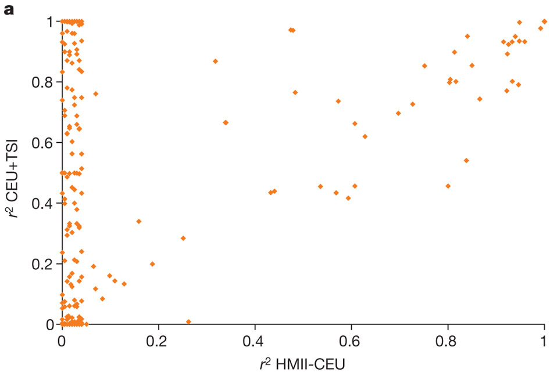
Reference panel size
(International HapMap Consortiumet al., 2010)
120 CEU chromosomes from the HapMap-II-sized versus 410 European-ancestry chromosomes from HapMap-III
Notes:
Rare SNPs (MAF <0.5%) from the Affymetrix 500K Chip SNPs on chromosome 20 imputed for 1,393 subjects of the 1958 British birth cohort
X axis: Imputed from a HapMap-II-sized panel of 120 CEU chromosomes (HMII-CEU)
Y axis : HapMap 3 panel of 410 European-ancestry chromosomes (CEU+TSI)
Mean r² between true and imputed genotype dosage for SNPs.

Slide 27
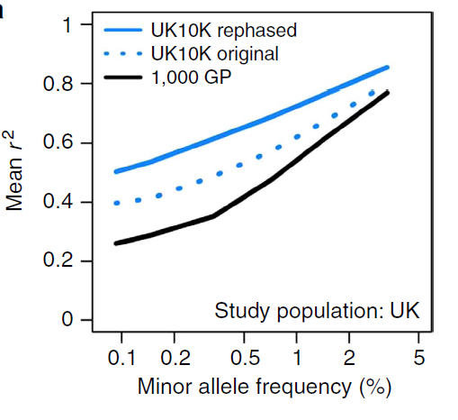
Reference panel size
(Huang et al., 2015)
1,092 samples from the 1000 Genomes project versus 3,781 UK10K samples imputed into GWAS data from the U.K.
Notes:
Rare SNPs (MAF <0.5%) from the Affymetrix 500K Chip SNPs on chromosome 20 imputed for 1,393 subjects of the 1958 British birth cohort
X axis: Imputed from a HapMap-II-sized panel of 120 CEU chromosomes (HMII-CEU)
Y axis : HapMap 3 panel of 410 European-ancestry chromosomes (CEU+TSI)
Mean r² between true and imputed genotype dosage for SNPs.

Slide 28
Reference Panels: Factors that affect imputation accuracy
Minor allele frequency
As minor allele frequency decreases imputation accuracy decreases. In other words rare SNPs are more difficult to impute than common SNPs;
Reference panel size
Imputation accuracy increases as reference panel size increases.
Reference panel composition
Using a combination of haplotype panels from worldwide populations can boost the performance of imputation, especially at rare SNPs, compared with using a single haplotype panel.

Slide 29
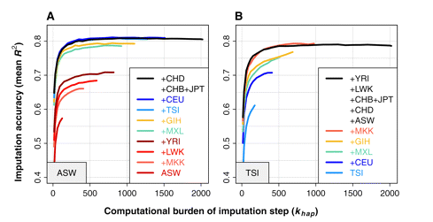
Reference panel composition
(Howie et al., 2011)
Improved imputation accuracy when using a worldwide reference panel
Notes:
Imputation accuracy at low-frequency SNPs in HapMap 3
True versus imputed SNPs in the African American (ASW) panel and the Italian (TSI) panel.
The accuracy of each experiment is plotted on the y-axis as the mean R2 across SNPs with MAF < 5%.
Plots shows accuracy as a function of reference panel composition and the number of haplotypes in the reference panel (used for inference) cross-validations in ASW and TSI, as a function of reference panel composition and khap value.
Each curve represents a different reference panel, with panels added cumulatively in the order shown in the legends

Slide 30
Future directions
Improved imputation of less well studied variants
Low frequency variants may be medically quite important
Still to expensive to conduct whole genome or exome sequencing
Accurate imputation of low frequency variants combined with next generation arrays can fill the gap.
Future resources
Larger and more diverse reference panels
1000 Genomes includes ~50%, 98% and 99.7% of the SNPs with frequencies of ~0.1%, 1.0% and 5.0%, respectively, in ~2,500 UK-sampled genomes
However, coverage may be lower for populations not closely related to those studied. Only 23.7%, 76.9% and 99.3% of the SNPs with frequencies of ~0.1%, 1.0% and 5.0%, respectively, in ~2,000 genomes sequenced in a study of the isolated population of Sardinia (the SardiNIA study).
UK10K project: 4000 samples from two UK cohorts sequenced at X6 depth
The Haplotype Reference Consortium (HRC): a large reference panel (n = 65,000) of human haplotypes generated by combining together sequencing data from multiple cohorts.
Improved phasing and imputation algorithms
Integration of sequence and array data to improve imputation accuracy

Slide 31
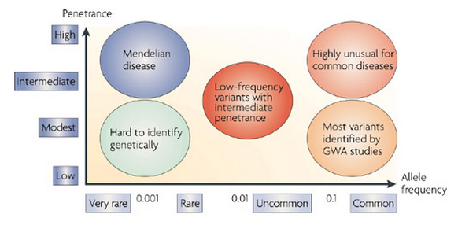
Improved imputation of less well studied variants
(McCarthy et al., 2008)
The role of low frequency variants (1% < MAF < 5%) in common diseases have been typically more difficult to assess due to more emphasis on the effect of common variants (MAF > 5%).
The effect of lower frequency variants on disease susceptibility is becoming more and more well studied.
Notes:
In humans, linkage studies have been successful in identifying highly penetrant genetic variants of large effect (odds ratio >100) underlying hundreds, if not thousands of Mendelian diseases
GWAS have identified 1000’s of SNPs that are strongly associated with common traits. Most of these SNPs are common (MAF >5%)
SNPs identified by GWAS explain only a part of the total heritability of these traits and less common SNPs may play a substantial role in identifying more robust associations.

Slide 32
Future directions
Improved imputation of less well studied variants
Low frequency variants may be medically quite important
Still to expensive to conduct whole genome or exome sequencing
Accurate imputation of low frequency variants combined with next generation arrays can fill the gap.
Future resources
Larger and more diverse reference panels
1000 Genomes includes ~50%, 98% and 99.7% of the SNPs with frequencies of ~0.1%, 1.0% and 5.0%, respectively, in ~2,500 UK-sampled genomes
However, coverage may be lower for populations not closely related to those studied. Only 23.7%, 76.9% and 99.3% of the SNPs with frequencies of ~0.1%, 1.0% and 5.0%, respectively, in ~2,000 genomes sequenced in a study of the isolated population of Sardinia (the SardiNIA study).
UK10K project: 4000 samples from two UK cohorts sequenced at X6 depth
The Haplotype Reference Consortium (HRC): a large reference panel (n = 65,000) of human haplotypes generated by combining together sequencing data from multiple cohorts.
Improved phasing and imputation algorithms
Integration of sequence and array data to improve imputation accuracy

Slide 33
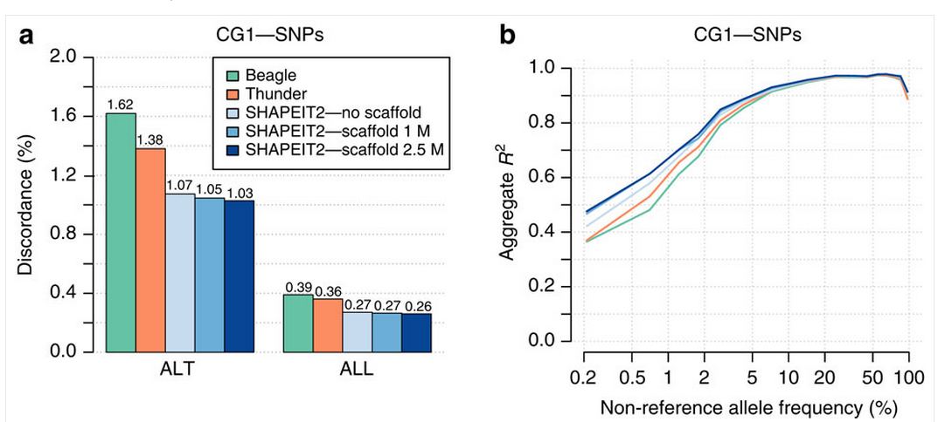
Integration of sequence and array data
(Delaneau et al., 2014)
Using data from SNP arrays combined with low read depth sequence data improves haplotype estimation in the 1000 Genomes Project which leads to improved imputation accuracy.

Slide 34
Association analysis with imputed data
Probabilistic outcomes
Directly genotyped data produces “hard calls” at bi-allelic markers. A subjects genotype can be one of three genotype combinations e.g. AA, AB or BB.
Imputation produces probabilities that represent the likelihood a subjects genotype is either AA, AB or BB.
In the table below, the probability that this subject is AA at SNP1 is 0.33. Similarly the probability that this subject is GT or TT at SNP2 is 0.
SNP | Name | Position | Allele A | Allele B | AA | AB | BB
SNP1 | rs1 | 100 | A | C | 0.33 | 0.77 | 0
SNP2 | rs2 | 200 | G | T | 1 | 0 | 0

Slide 35
Association analysis with imputed data
These probabilities can be used to “count” the expected number of reference alleles an individual has and plugged into the usual regression analysis as an independent variable.
The expected number of counts of the reference allele A is 2*prob(AA) + 1*prob(AB).
For example at SNP1, the expected number of counts of the A allele is 2*0.33 + 1*0.77 = 1.43, while at SNP2 it is 2*1 + 1*0 = 2.
SNP | Name | Position | Allele A | Allele B | AA | AB | BB
SNP1 | rs1 | 100 | A | C | 0.33 | 0.77 | 0
SNP2 | rs2 | 200 | G | T | 1 | 0 | 0

Slide 36
Association analysis with imputed data
Validation of imputation accuracy
Some frequently used imputation software (e.g. IMPUTE2) provide estimates of imputation accuracy
Here the directly genotyped markers are hidden from the program one at a time and then imputed as if they were missing.
The imputed and actual genotypes are compared to give an indication of imputation accuracy at these sites.
The overall concordance between actual and imputed genotypes indicates if the imputation is not accurate enough
This indicates accuracy at markers where observed data is available only.
Imputation accuracy at missing markers is estimated and included in imputation output in frequently used imputation software
This is a measure of confidence in the accuracy of imputation
Often it ranges from 0 to 1, with higher values indicated greater confidence
Markers with lower values should be removed
The threshold to identify such varies depending on the program used
If low quality markers are not removed the false positive rate will tend to increase

Slide 37
References
Marchini, J., and Howie, B. (2010). Genotype imputation for genome-wide association studies. Nature reviews Genetics 11, 499-511.
Huang, J., Ellinghaus, D., Franke, A., Howie, B., and Li, Y. (2012). 1000 Genomes-based imputation identifies novel and refined associations for the Wellcome Trust Case Control Consortium phase 1 Data. European journal of human genetics : EJHG 20, 801-805.
Hindorff, L.A., Sethupathy, P., Junkins, H.A., Ramos, E.M., Mehta, J.P., Collins, F.S., and Manolio, T.A. (2009). Potential etiologic and functional implications of genome-wide association loci for human diseases and traits. Proceedings of the National Academy of Sciences of the United States of America 106, 9362-9367.
Spencer, C.C., Su, Z., Donnelly, P., and Marchini, J. (2009). Designing genome-wide association studies: sample size, power, imputation, and the choice of genotyping chip. PLoS genetics 5, e1000477.
Bis, J.C., Kavousi, M., Franceschini, N., Isaacs, A., Abecasis, G.R., Schminke, U., Post, W.S., Smith, A.V., Cupples, L.A., Markus, H.S., et al. (2011). Meta-analysis of genome-wide association studies from the CHARGE consortium identifies common variants associated with carotid intima media thickness and plaque. Nature genetics 43, 940-947.
International HapMap, C. (2005). A haplotype map of the human genome. Nature 437, 1299-1320.
Clark, A.G. (1990) Inference of haplotypes from PCR-amplified samples of diploid populations. Mol Biol Evol, 7, 111-122.
Excoffier, L. and Slatkin, M. (1995) Maximum-likelihood estimation of molecular haplotype frequencies in a diploid population. Mol Biol Evol, 12, 921-927.
Huang, J., Howie, B., McCarthy, S., Memari, Y., Walter, K., Min, J.L., Danecek, P., Malerba, G., Trabetti, E., Zheng, H.F. et al. (2015) Improved imputation of low-frequency and rare variants using the UK10K haplotype reference panel. Nature communications, 6, 8111.
Howie, B., Marchini, J., and Stephens, M. (2011). Genotype imputation with thousands of genomes. G3 1, 457-470.
International HapMap, C., Altshuler, D.M., Gibbs, R.A., Peltonen, L., Altshuler, D.M., Gibbs, R.A., Peltonen, L., Dermitzakis, E., Schaffner, S.F., Yu, F., et al. (2010). Integrating common and rare genetic variation in diverse human populations. Nature 467, 52-58.
McCarthy, M.I., Abecasis, G.R., Cardon, L.R., Goldstein, D.B., Little, J., Ioannidis, J.P., and Hirschhorn, J.N. (2008). Genome-wide association studies for complex traits: consensus, uncertainty and challenges. Nature reviews Genetics 9, 356-369.
Delaneau, O., Marchini, J., Genomes Project, C., and Genomes Project, C. (2014). Integrating sequence and array data to create an improved 1000 Genomes Project haplotype reference panel. Nature communications 5, 3934.

